Slide 1

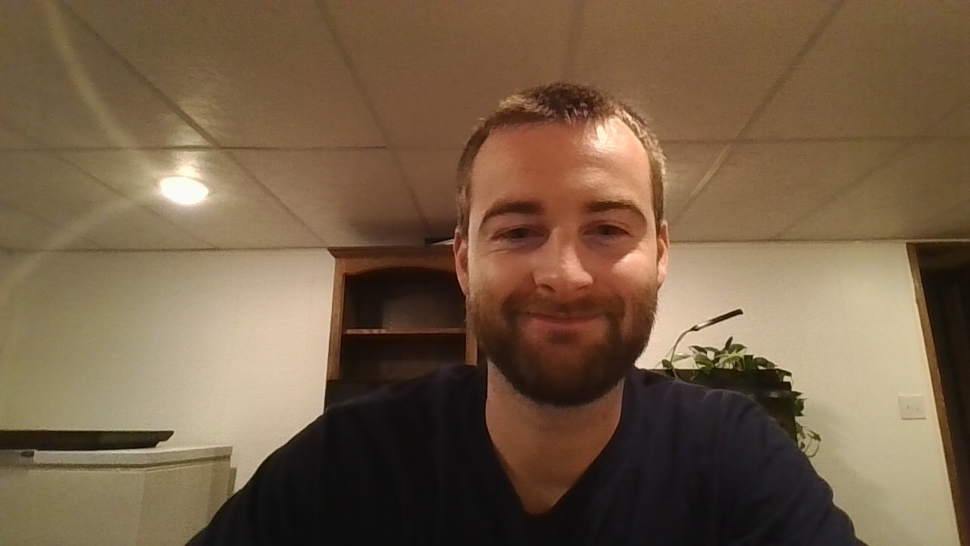
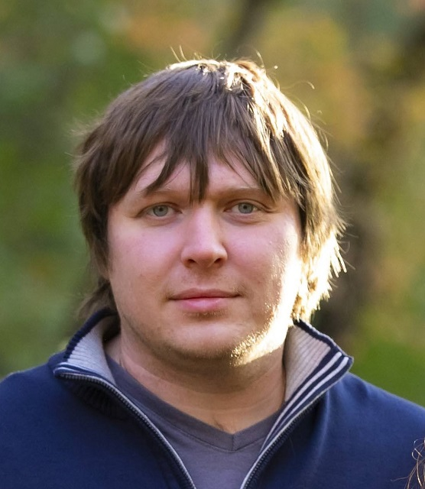

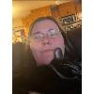

Doomsday Database
Ben G, Denis B, Jack K, Maggie B, and Nathan B

Slide 2
Outline
A world wrought by the virus "The Fade" where civilization has collapsed into shelters and factions where people struggle to survive with limited resources and personnel
A database has been created with the goal to help survivors not run out of necessary supplies, skills, and allies
Tasks divided and completed
This presentation will run through the database and how it is effective

Slide 3
Group Roles and Rules
Roles
Queries, Triggers, Stored Procedures, Views: Jack and Maggie
Database: everyone
Recorder/Submitter/Security: Nathan B
Version Control/Spokesperson: Denis
ERD/Constraints: Ben
Scheduler/Time Management: Maggie
General Rules
Communicate often
Clear goals first day
Using discord, GitHub, and excel to work collaboratively

Slide 4
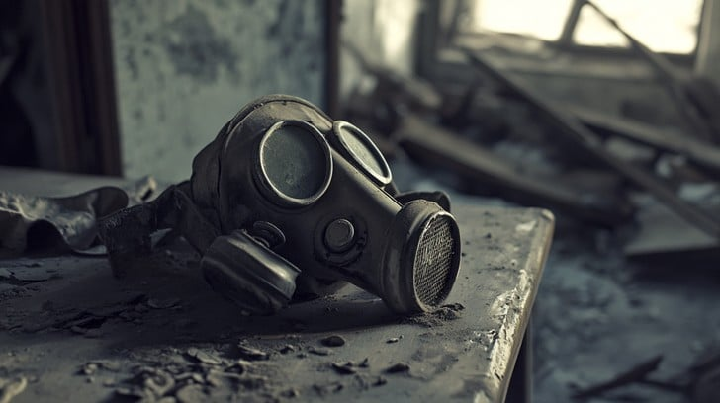
Problems Facing the Survivors
Lethal Virus
A highly lethal virus named The Fade has caused widespread devastation.
Society Collapse
There are no longer enough people to maintain modern infrastructure.
Resource Scarcity
Necessities such as clean water, and power are difficult to secure.
Competing Factions
Rival groups now compete for scarce resources.
Stockcake. "Abandoned gas mask" Free Abandoned gas mask Photo - Abandoned, Mask, Dusty | Download at StockCake
Notes:
In this post-apocalypse setting, problems are numerous and dire. With the onset of The Fade, a contagious and highly lethal virus that can progressively impair brain function to the point of whole-body shutdown, civilization has collapsed.
Modern society depended upon highly specialized business sectors to produce goods efficiently and at scale. The virus has wiped out a staggeringly high percentage of the human race, making this way of life impossible due to lack of manpower. Food production has fallen apart, clean water is difficult to obtain, and reliable power sources are rare. Subsistence living has become the new normal as securing basic necessities for survival takes up the majority of an individual's daily life. Resource sites such as hunting grounds and salvage areas are now critical lifelines.
The degradation of society has led groups of people to break apart and form factions. Any interaction between factions can potentially turn deadly. The Survivors are a faction consisting of motivated people fighting to rebuild civilization. Their members have a wide range of skills including First Aid, Maintenance, Carpentry, and Farming, and they are assigned tasks based on these abilities.
Because resources are scarce, every tool, food stash, and piece of equipment must be carefully accounted for. With trust in traditional currency systems diminished, most trade has shifted to a bartering system. Since bartering is now the most common system of exchange, the Survivors have assigned theoretical values to all items and supplies.
The Survivors have created a database to track resource availability, their members, supplies, and interactions with outside factions, to assist in their goal of restoring society to its former level of prosperity.

Slide 5
Supplies, Power, Water
These are managed through the Item, Inventory, Power Source, Water Source and Resource Site tables.
Item table contains details about an item itself, like the name, what category it is in, if it is a type of currency and how valuable it is compared to a universal currency.
Power Source has details about specific power sources, the name, a description, whether it is still active, and if it is easily moveable.
Water Source has details like the name of the source, a description and the quality of the water.
Resource Site contains details like city, the type of resource it is, the name of the site, a description and it is still usable.
These are connected to individual shelters through their own junction tables. Inventory also specifies quantity of the linked item. Shelter_Power and Shelter_Water just connect potentially shared resources to a given shelter.
These interactions can be queried to see how a shelter is doing. If they have power, if they have food and water, or if they need to think about moving survivors and resources around.

Slide 6
People, Skills, Locations
These are managed through the Survivors, Skills, Shelters, Cities, Status, and Disease Case tables.
Survivor table contains details about survivors themselves first and last name, birthdate, where they live.
Skills table describes and names a skill.
City table has the name and state the city is located in.
Shelter table details the city it is in, a name, and the number of survivors it can comfortably sustain/house.
Status is a general quick glance survivor status. Disease Case is focused on The Fade itself.
There are only a couple junction tables here focused on survivors. The Survivor Skill table and the Survivor Encounter table. This ensures that we can accurately track shared skills and encounters.
These tables can be queried to check on survivor health, how comfortable a shelter is, and how many resources are left in a city.

Slide 7
Allies and Adversaries
These are managed through the Faction, Faction Relations, and Encounter tables.
Faction table has details like the name of the faction, what type of faction they are and the attitude they have to the database owners.
Encounter table details the date of an encounter, what type of encounter it was, the vibe/attitude of the encounter, and a description of the encounter.
Faction Relations is a special junction table linking Faction to itself and it is what the database owners know about the relationship between two outside factions.
The other junction tables are between survivors and encounters and factions and encounters has multiple factions, and survivors could be involved in one encounter.
These could be queried to see if a faction is hostile or not, they could be audited for whether a faction’s attitude needs to be updated in the system or help predict if a meeting between two outside factions could be mean danger.

Slide 8
Data Integrity
To ensure data integrity, we enforce constraints applied to the attributes.
We use primary and foreign keys to ensure that non-key attributes depend only on the primary key (according to Third Normal Form).
Our group implemented transactions, we specifically used a rollback transaction to prevent some triggers from executing in the event of an error.
We also created queries, views, and stored procedures to organize reusable logic and securely manage operations. We used triggers for enforcing additional rules that cannot be handled by constraints.

Slide 9
Queries, Triggers, Procedures, & Views
Queries and Views
Our queries allow us to stay informed about the ongoing state of our survivors, shelters, and relations with other factions.
Helps allocate items and survivors to where they are critically needed.
Allows for easily keeping tabs on other factions and how we should interact with them
Triggers
Helps with data integrity by catching issues that check constraints might miss.
Stops users from preforming actions that should be avoided.
Stores Procedures
Provides ways for users to safely interact with the database.
Allows for some lower-level users to preform limited deletion and updates as seen fit by our security protocols.
Makes it easy to do complex searches of the database by just passing in the parameters.
Notes:
Jack

Slide 10
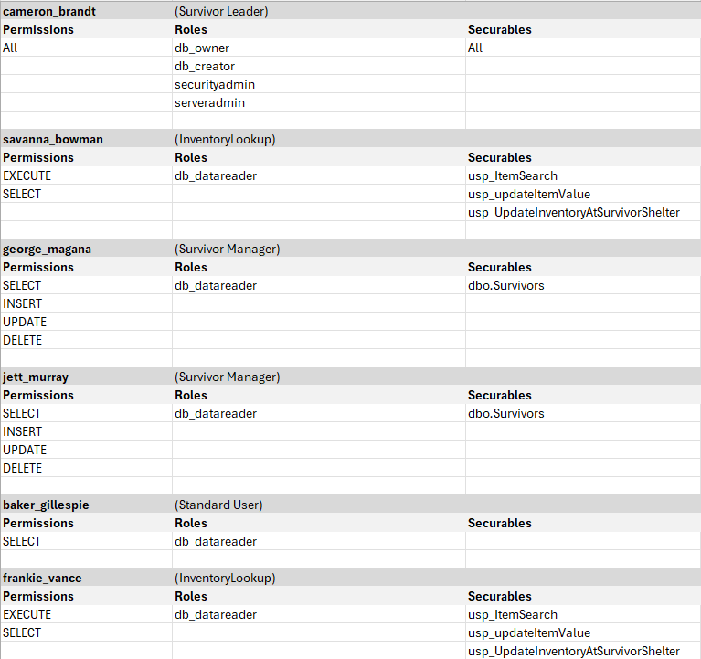
Security
Security in the database is handled on a per survivor basis.
All survivors have read access to tables.
Two survivors have access to modify the survivor table with insert, update, and delete.
Two survivors have access to certain stored procedures to help them with maintaining inventory and item values.
One survivor has full access to the server and database, allowing them to manage access and the database itself.

Slide 11
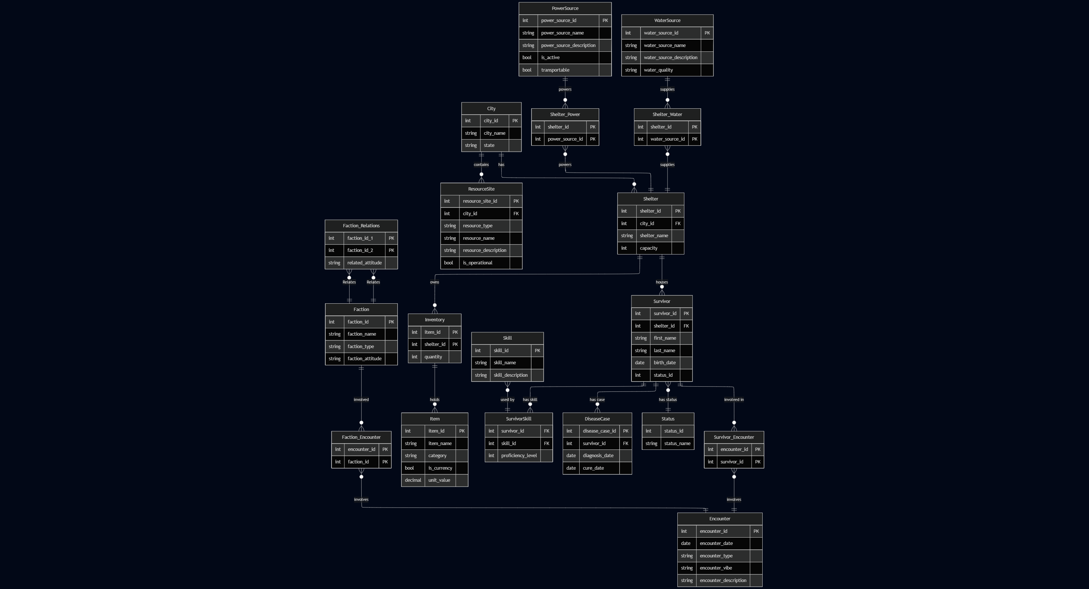
ERD
Notes:
In this slide, I will give an overview of the whole ERD. The core of the design is the City, shelter, and Survivors. Survivors live in shelters in a city, and the rest of the tables and data relationships flow outward from these three core entities.. The PowerSource and Watersource represent the utilities available for each shelter through their respective linking tables. The inventory and Item tables are also offshoots of the shelter table, showing which items belong to a given shelter.
The ResourceSite table branches from the City table. It shows sites of interest that are present within a city, such as scavenging and hunting areas. The Skill, DiseaseCase, and Status table all outline qualities and descriptions of the members in the Survivors table. The biggest branch off of the Survivor table is the chain of tables that make up encounters. The Encounter and Faction tables handle information pertaining to run ins and events that occur between the Survivors and other factions, as well as valuable information on the outside factions such as their name and general attitude toward the survivors.
We put a lot of work into the ERD at the beginning of the project, so we did not need to add or remove tables to finalize our database. We created CHECK constraints instead of adding more lookup tables to insure data consistency and we decided what string and numerical values were appropriate to implement.

Slide 12
Project Results
A clean detailed database whose data helps survivors of this world keep track of supplies, medical, personnel, and allies to survive.
Created queries, views, triggers, and stored procedures that assist in keeping track of data and in making decisions
Security that ensures those who change the database are alive and trusted
Data integrity that ensures data stays consistent, accurate, and trustworthy
Our database successfully met our original goals and performs as intended

Slide 13
Lessons Learned
How to best decide and distribute tasks/roles on a given project
Time management
Benefits of communicating often and updating others on actions taken
Implementing security in a database
How to handle specific problems within scenario with a database
Working collaboratively on SQL files
Creating relevant queries and procedures

